Slide 1



Week 2
the interaction

Slide 2
In the last lecture
Interaction Design

Slide 3
What is Interaction Design
Interaction Design (IxD) is the design of interactive products and services in which a designer’s focus goes beyond the item in development to include the way users will interact with it.
Close scrutiny of users’ needs, limitations and contexts, etc. empowers designers to customize output to suit precise demands.
Reference: https://www.interaction-design.org/literature/topics/interaction-design

Slide 4
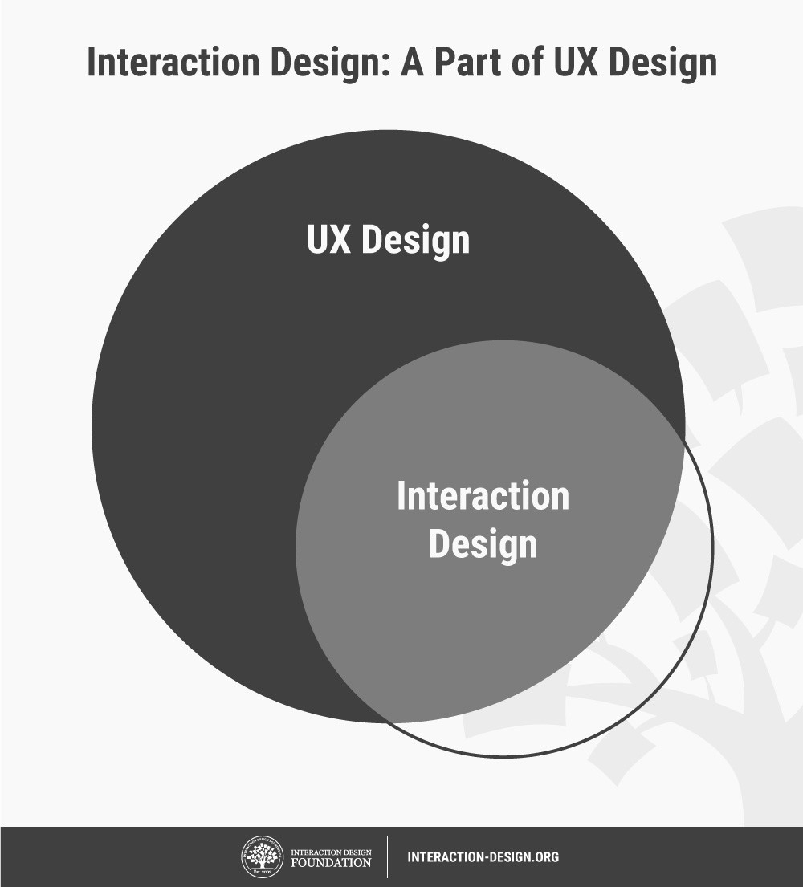
Interaction Design is a Part of User Experience Design
Reference: https://www.interaction-design.org/literature/topics/interaction-design

Slide 5
What is Interaction Design
Designers’ work in IxD involves five dimensions:
  words (1D),
  visual representations (2D),
  physical objects/space (3D),
  time (4D), and
  behavior (5D).
Reference: https://www.interaction-design.org/literature/topics/interaction-design

Slide 6
What is Interaction Design
Designers’ work in IxD involves five dimensions:
  words (1D),
    Words (1D) encompass text, such as button labels, which help give users the right amount of information.
  visual representations (2D),
    Visual representations (2D) are graphical elements such as images, typography and icons that aid in user interaction.
  physical objects/space (3D),
    Physical objects/space (3D) refers to the medium through which users interact with the product or service—for instance, a laptop via a mouse, or a mobile phone via fingers.
Reference: https://www.interaction-design.org/literature/topics/interaction-design

Slide 7
What is Interaction Design
Designers’ work in IxD involves five dimensions:
  time (4D),
    Time (4D) relates to media that changes with time, such as animations, videos and sounds.
  behavior (5D).
    Behavior (5D) is concerned with how the previous four dimensions define the interactions a product affords—for instance, how users can perform actions on a website, or how users can operate a car. Behavior also refers to how the product reacts to the users’ inputs and provides feedback.
Reference: https://www.interaction-design.org/literature/topics/interaction-design

Slide 8
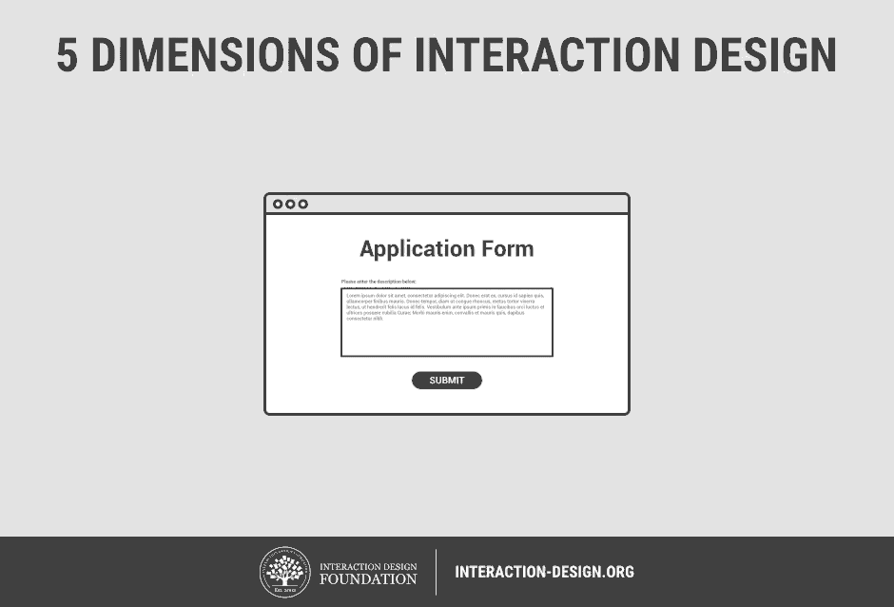
What is Interaction Design
Reference: https://www.interaction-design.org/literature/topics/interaction-design

Slide 9
In Today’s Lecture
Interaction Framework

Slide 10

What is Interaction?
communication

Slide 11
What is interaction?
communication
user  system
but is that all … ?
  see “language and action” in Later lectures …

Slide 12
The Interaction
interaction models
  translations between user and system
ergonomics
  physical characteristics of interaction
interaction styles
  the nature of user/system dialog
context
  social, organizational, motivational

Slide 13
Common interaction styles
command line interface
menus
natural language
question/answer and query dialogue
form-fills and spreadsheets
WIMP
point and click
three–dimensional interfaces

Slide 14
models of interaction
terms of interaction
Norman model
interaction framework

Slide 15
Some terms of interaction
domain – the area of work under study
  e.g. graphic design
goal – what you want to achieve
  e.g. create a solid red triangle
task – how you go about doing it
– ultimately in terms of operations or actions
  e.g. … select fill tool, click over triangle
Note …
  traditional interaction …
  use of terms differs a lot especially task/goal !!!

Slide 16
Donald Norman’s Model
Norman’s model concentrates on user’s view of the interface
goal
execution
evaluation
system

Slide 17
Donald Norman’s model
Seven stages
  user establishes the goal
  formulates intention
  specifies actions at interface
  executes action
  perceives system state
  interprets system state
  evaluates system state with respect to goal
Norman’s model concentrates on user’s view of the interface

Slide 18
execution/evaluation loop
goal
    user establishes the goal
    formulates intention
    specifies actions at interface
    executes action
    perceives system state
    interprets system state
    evaluates system state with respect to goal
execution
evaluation
system

Slide 19
execution/evaluation loop
goal
    user establishes the goal
    formulates intention
    specifies actions at interface
    executes action
    perceives system state
    interprets system state
    evaluates system state with respect to goal
execution
evaluation
system

Slide 20
execution/evaluation loop
goal
    user establishes the goal
    formulates intention
    specifies actions at interface
    executes action
    perceives system state
    interprets system state
    evaluates system state with respect to goal
execution
evaluation
system

Slide 21
execution/evaluation loop
goal
    user establishes the goal
    formulates intention
    specifies actions at interface
    executes action
    perceives system state
    interprets system state
    evaluates system state with respect to goal
execution
evaluation
system

Slide 22
Structure of an Action
Example
  Night time sitting in chair, reading a book. Need light
Goal
(Some thing to be achieved)
Get more Light
translate
Intention
(Specific action taken to get the goal)
Push switch button to ON lamp
translate
Move Body
Stretch
Extend finger

Slide 23
Using Norman’s model
Some systems are harder to use than others
Gulf of Execution
  user’s formulation of actions
  ≠ actions allowed by the system
Gulf of Evaluation
  user’s expectation of changed system state
  ≠ actual presentation of this state

Slide 24

Human error - slips and mistakes
slip
  understand system and goal
  correct formulation of action
  incorrect action
mistake
  may not even have right goal!
Fixing things?
slip – better interface design
mistake – better understanding of system

Slide 25
Abowd and Beale framework
extension of Norman…
their interaction framework has 4 parts
  user
  input
  system
  output
each has its own unique language
interaction ⇒ translation between languages
problems in interaction = problems in translation
O
output
S
core
U
task
I
input

Slide 26
Using Abowd & Beale’s model
user intentions
→ translated into actions at the interface
→ translated into alterations of system state
→ reflected in the output display
→ interpreted by the user
general framework for understanding interaction
  not restricted to electronic computer systems
  identifies all major components involved in interaction
  allows comparative assessment of systems
  an abstraction

Slide 27
Abowd and Beale framework
O
output
Presentation
Observation
S
core
U
task
I
input
Articulation
Performance

Slide 28
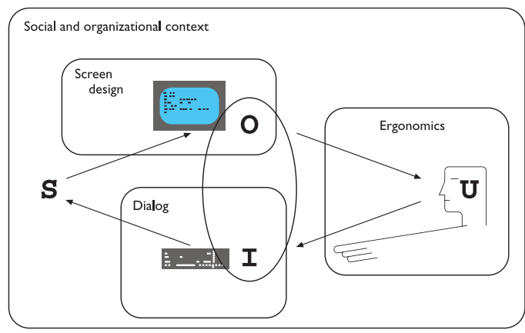
HCI and Frameworks

Slide 29
ergonomics
physical aspects of interfaces
industrial interfaces

Slide 30
Ergonomics
Study of the physical characteristics of interaction
Also known as human factors – but this can also be used to mean much of HCI!
Ergonomics good at defining standards and guidelines for constraining the way we design certain aspects of systems

Slide 31
Ergonomics - examples
arrangement of controls and displays
  e.g. controls grouped according to function or frequency of use, or sequentially
surrounding environment
  e.g. seating arrangements adaptable to cope with all sizes of user
health issues
  e.g. physical position, environmental conditions (temperature, humidity), lighting, noise,
use of colour
  e.g. use of red for warning, green for okay,
  awareness of colour-blindness etc.

Slide 32

Industrial interfaces
Office interface vs. industrial interface?
Context matters!
office industrial
type of data textual numeric
rate of change slow fast
environment clean dirty
… the oil soaked mouse!

Slide 33
Glass interfaces ?
industrial interface:
  traditional … dials and knobs
  now … screens and keypads
glass interface
  cheaper, more flexible,
  multiple representations,
  precise values
  not physically located,
  loss of context,
  complex interfaces
may need both
Vessel B Temp
0
100
200
113
multiple representations
of same information

Slide 34
Indirect manipulation
office– direct manipulation
  user interacts
  with artificial world
system
industrial – indirect manipulation
  user interacts
  with real world
  through interface
issues ..
  feedback
  delays
interface
plant
immediate
feedback
instruments

Slide 35
interaction styles
dialogue … computer and user
distinct styles of interaction

Slide 36
Common interaction styles
command line interface
menus
natural language
question/answer and query dialogue
form-fills and spreadsheets
WIMP
point and click
three–dimensional interfaces

Slide 37
Command line interface
Way of expressing instructions to the computer directly
  function keys, single characters, short abbreviations, whole words, or a combination
suitable for repetitive tasks
better for expert users than novices
offers direct access to system functionality
command names/abbreviations should be meaningful!
Typical example: the Unix system

Slide 38
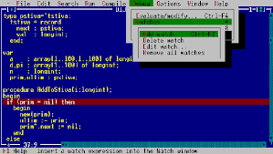
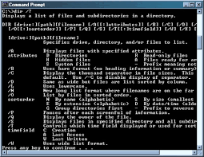
Examples

Slide 39
Menus
Set of options displayed on the screen
Options visible
  less recall - easier to use
  rely on recognition so names should be meaningful
Selection by:
  numbers, letters, arrow keys, mouse
  combination (e.g. mouse plus accelerators)
Often options hierarchically grouped
  sensible grouping is needed
Restricted form of full WIMP system

Slide 40
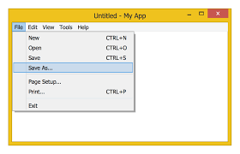
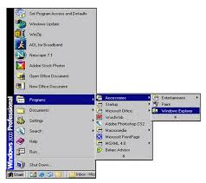
Menu based Example
Menu based Example

Slide 41
Natural language
Familiar to user
speech recognition or typed natural language
Problems
  vague
  ambiguous
  hard to do well!
Solutions
  try to understand a subset
  pick on key words

Slide 42
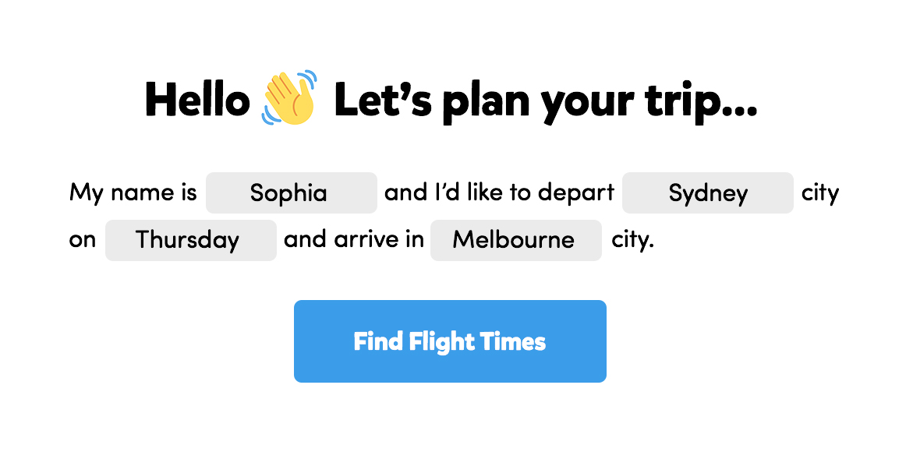
Example

Slide 43
Query interfaces
Question/answer interfaces
  user led through interaction via series of questions
  suitable for novice users but restricted functionality
  often used in information systems
Query languages (e.g. SQL)
  used to retrieve information from database
  requires understanding of database structure and language syntax, hence requires some expertise

Slide 44
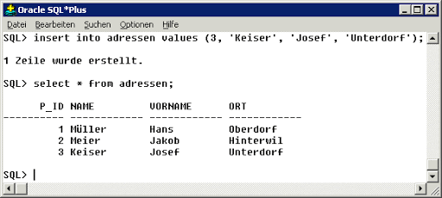
Example

Slide 45
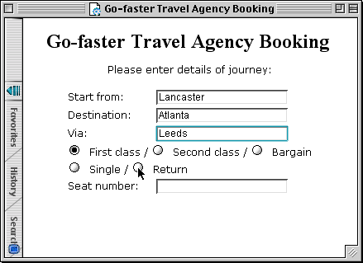
Form-fills
Primarily for data entry or data retrieval
Screen like paper form.
Data put in relevant place
Requires
  good design
  obvious correction
  facilities

Slide 46
Spreadsheets
first spreadsheet VISICALC, followed by Lotus 1-2-3
MS Excel most common today
sophisticated variation of form-filling.
  grid of cells contain a value or a formula
  formula can involve values of other cells
  e.g. sum of all cells in this column
  user can enter and alter data spreadsheet maintains consistency

Slide 47
WIMP Interface
Windows
Icons
Menus
Pointers
… or windows, icons, mice, and pull-down menus!
default style for majority of interactive computer systems, especially PCs and desktop machines

Slide 48
Point and click interfaces
used in ..
  multimedia
  web browsers
  hypertext
just click something!
  icons, text links or location on map
minimal typing

Slide 49


Three dimensional interfaces
virtual reality
‘ordinary’ window systems
  highlighting
  visual affordance
  indiscriminate use
  just confusing!
3D workspaces
  use for extra virtual space
  light and occlusion give depth
  distance effects
flat buttons …
click me!
… or sculptured

Slide 50
Context
Interaction affected by social and organizational context
other people
  desire to impress, competition, fear of failure
motivation
  fear, allegiance, ambition, self-satisfaction
inadequate systems
  cause frustration and lack of motivation

